Slide 1
Digital portfolio
StUDent name : Preethi.s
Register No and nmid : 6BE760a689a3feb0ea479467
Department : BCA
College : Aksheyaa college of arts and science/ University of Madras.

Slide 2
PROJECT TITLE
✅ Simple & formal Titles (best for resume/project report)
Digital Portfolio Development
Design and Implementation of a Digital Portfolio
Web Based Digital Portfolio System
Personal Digital Portfolio Website
Interactive Digital Portfolio

Slide 3
AGENDA
Problem Statement
Project Overview
End Users
Tools and Techniques
Portfolio design and Layout
Features and Functionality
Results and Screenshot
Conclusion
GitHub link

Slide 4
PROBLEM STATEMENT
A normal paper resume is plain and limited in design,which makes it hard to show creativity and stand out. To solve this, I create a digital resume that presents my personal details, skills, education and projects in a clear, attractive, and easily accessible way.

Slide 5
Project Overview
The project focuses on developing a Digital Portfolio Website to showcase personal details, academic background, technical skills,and project work. The portfolio emphasizes user-friendly design,responsive layout, and interactive elements, enabling viewers to navigate easily and understand the profile.

Slide 6
Who are the End Users ?
Students & Professionals – To showcase their skills and achievements.
Recruiter’s & Employers – To evaluate candidates ‘capabilities a traditional resume .
Academic Institutions – For student’s project submissions and evaluation.

Slide 7
TOOLS AND TECHNIQUES
Front-end : HTML,CSS,JAVAScript.
Version Control : GitHub
Design tools : Canva ( for layout design)

Slide 8
PORTFOLIO DESIGN AND LAYOUT
Home page : Introduction and Banner Section.
About section : Personal Details, Academic Profile.
Skills Section : Technical expertise and Skills.
Content Section : Address, email and phone number.

Slide 9
PORTFOLIO DESIGN AND LAYOUT
Proper use of fonts,spacing and alignment makes the design professional.
The Layout is simple, attractive, and user- friendly,making the information easy to follow.

Slide 10
FEATURES AND FUNCTIONALITY
Provide a clear and organized structure for personal, academic,and professional details.
Interactive navigation with responsive design.
Accessible anytime and anywhere in digital format.
Compatible across devices such as laptops, tablets, and smartphones.
Easy and attractive Resume model .

Slide 11
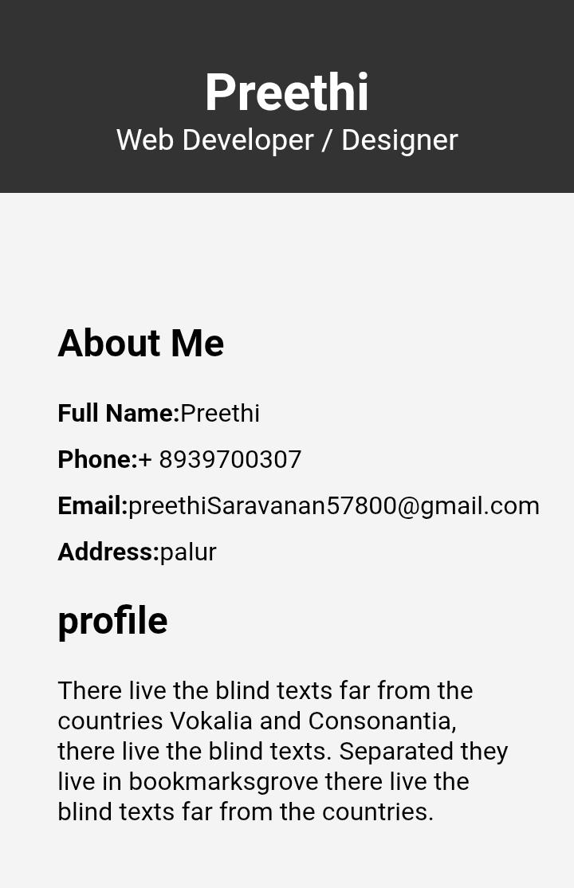
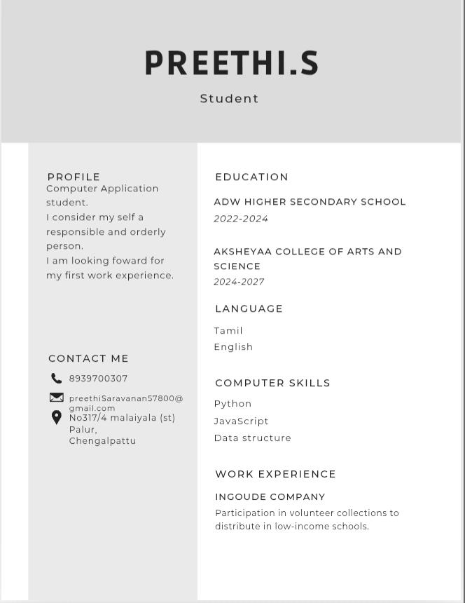
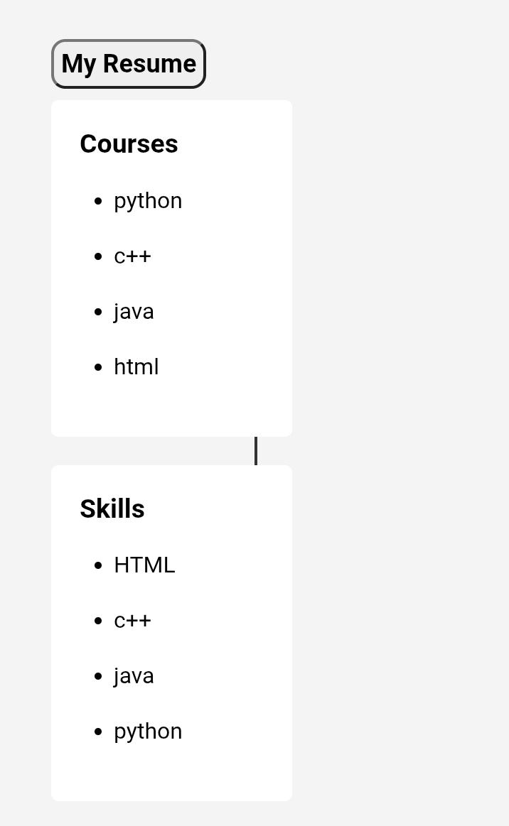
RESULT AND SCREENSHOT

Slide 12
CONCLUSION
This project provides a simple and creative way to present details in a digital format. It is easy to update, accessible, and more attractive than a traditional resume.

Slide 13
GITHUB LINK
Preethisaravanan57800-lgtm/digital_portfolio

